Slide 1



BRYNTEG NEWS
October
2026
MESSAGE FROM THE HEADTEACHER
As we reach the end of another long half term, I would like to thank everyone for their continued support.
Our pupils have enjoyed visits to local history centres, represented the school in a range of sporting events, worked with visiting sports specialists, and taken part in exciting projects with artists. These opportunities have helped to make this a memorable and rewarding half term for our children.
Like many schools, we have been affected by a number of illnesses this term. We have really appreciated the communication, understanding and support from parents throughout this period. Thank you for working with us to help keep everyone as healthy as possible.
I hope you all have a lovely, restful half term break and enjoy spending time with family and friends. If you are attending any Halloween events, please take care and stay safe.
We look forward to welcoming everyone back
after the holiday. Best wishes.
Mrs Firth
COMMUNICATION
Keep up to date with all that’s happening by visiting our website or following us on Facebook.
Please ensure we have your current mobile number so you receive our text messages, and don’t forget to sign up to Seesaw to see what’s happening in your child’s class.
You can also subscribe to our diary for Android or iOS. You can find the link on our website: https://www.brynteg-pri.wrexham.sch.uk/

Slide 2

DATES FOR YOUR DIARY
Please note - These dates are subject to change
JULY 2026 | SEPTEMBER 2026 | OCTOBER 2026
Friday 17th Last day of school | Tuesday 1st Staff training day Wednesday 2nd School open to pupils Friday 11th Individual photos Monday 15th Swimming – Magpies Thursday 17th Flu immunisation | Wednesday 21st Parents Evening Friday 23rd Half term
NOVEMBER 2026 | DECEMBER 2026 | JANUARY 2027
Monday 2nd Staff training day Tuesday 3rd School open to pupils Friday 6th Dangerpoint Trip – Magpies and Dragons Friday 13th Children in Need Monday 16th November Visit to Mayor's Parlour – School Council Thursday 19th AGM Governors and Parents Thursday 26th Non Uniform Day Friday 27th Christmas Fair | Wednesday 2nd Pinocchio Trip – Dragons Thursday 3rd Pinocchio Trip – Rhinos Monday 7th Reception – Y2 Concert Tuesday 8th Y3 – Y6 Concert Wednesday 9th Nursery Concert Pinocchio Trip – Magpies Thursday 10th Christmas Lunch Tuesday 15th The Littlest Yak Trip - Robins Wednesday 16th The Littlest Yak Trip - Woodpeckers Thursday 17th End of term Friday 18th Staff training day | Monday 4th Staff training day Tuesday 5th School open to pupils
FEBRUARY 2027 | MARCH 2027 | APRIL 2027
Monday 1st Parents evening this week Friday 5th School closes for half term Monday 15th School open to pupils | Wednesday 10th Class photos Friday 19th End of term Date to be confirmed Red Nose Day | Monday 5th School open to pupils
MAY 2027 | JUNE 2027 | JULY 2027
Monday 3rd May Day Monday 10th Bikeability (Y5/6) Tuesday 11th Bikeability (Y5/6) Friday 28th Half term | Monday 7th School open to pupils Friday 18th Sports Day Monday 21st Scholastic Book Fair Tuesday 22nd Scholastic Book Fair | Friday 9th Pupil reports to parents Friday 16th School closes for end of year

Slide 3


MY CHILD AT SCHOOL (MCAS)
After half term, we will be introducing My Child at
School (MCAS), an app that allows parents and
carers to access information about their child and
communicate more easily with the school.
As a first step, we will be rolling out the attendance
function. This will enable you to monitor your child’s
attendance and report absences directly through the
app, making it quicker and easier to keep us informed.
Following the half term break, we will send an activation email to all parents and carers. We will let you know when these emails have been sent, as you will have 24 hours to activate your account using the link provided.
We hope that you will find MCAS a useful communication tool, and we look forward to introducing additional features over time. Thank you for your support as we begin to roll out this new system.
ATTENDANCE
A special well done to Dragon Class, who currently have the highest attendance in the school at 95.1%. They are closely followed by Magpies Class with an excellent 93.5% attendance.
We would also like to congratulate Robins Class, who have recorded the fewest late arrivals this term. Arriving at school on time helps children settle into the day calmly and ensures they do not miss valuable learning time.
Our current whole-school attendance figure is 92%. While we have experienced a significant amount of illness across the school this term, attendance has also been affected by holidays taken during term time. In fact, one third of all absences this term have been due to holidays.
We would like to remind parents that we are not permitted to authorise holidays during term time unless there are exceptional circumstances. Please refer to the Attendance Policy on the school website for further information.
It is also important to be aware of the rules regarding lateness. Children should be in school and ready to learn on time each day. If a child arrives after 9:20am, the entire morning session is recorded as an unauthorised absence and contributes to their overall attendance record.
Parents should also be aware that the Local Authority’s absence procedures begin when a child reaches 10 sessions of absence, which is the equivalent of 5 school days.
Thank you for your continued support in helping us improve attendance. By working together, we can ensure that every child has the best possible opportunity to learn, achieve and enjoy school.

Slide 4


ILLNESSES
Over the last half term, we have seen a number of
childhood illnesses affect pupils across the school.
We understand that this can be worrying and
frustrating for parents, particularly when there may
be concerns about whether children should be
attending
school while unwell.
As a school, we follow the guidance provided by
Public Health Wales and use this as the basis for our
decision-making and procedures. We are not medical professionals and must rely on the information available to us, both through what we observe in school and what is shared with us by parents and carers.
We appreciate that there may be times when parents feel that another child should not be in school, or that their own child is being exposed to illness. However, any decisions we make are based on the information presented to us and the guidance available at the time. We do not make assumptions and can only act on the information we have received.
Where required, we notify parents and carers of illnesses in school in line with guidance from Public Health Wales. We regularly refer to their published advice and seek further guidance when necessary.
Clear communication between home and school is essential. We would therefore encourage all parents and carers to keep us informed if their child is diagnosed with an illness or if they are seeking advice about whether their child is well enough to attend school.
For your reference, further information about common childhood illnesses and recommended exclusion periods can be found here:
https://phw.nhs.wales/resources/exclusion-period-for-common-infections-including-a-z-of-common-infections-and-next-steps/
Thank you for your understanding and support as we work together to keep our school community healthy and safe.
PUPIL SAFETY
We have noticed an increase in the number of pupils walking
across the car park to access the school site.
Please remember that the car park can be a busy and
potentially dangerous area. To help keep all pupils safe, we
kindly ask that children and families use the main pedestrian
path when arriving at and leaving school.
Thank you for your cooperation and support in helping us maintain a safe environment for everyone.

Slide 5


SCHOOL COUNCIL
Earlier this term, pupils took part in our
School Council elections and each class
voted for two representatives to speak
On their behalf.
Congratulations to Lyla, Theo, Max,
Jayde, Connor, Nyla, Max and Oliver,
who were successfully elected to
represent their classes.
The newly elected School Council
members have already attended their
first meetings and are taking their roles
very seriously. Their job is to help make
our school an even better place for all
pupils by listening to the views of their
classmates and helping to bring about positive change.
Their first task has been to write to our catering team to discuss possible changes to the menu. They have also identified several key areas they would like to focus on this year, including improving the school environment, enhancing playtimes and continuing to develop our charity work within the local community.
To help them learn more about how decisions are made and how they can create lasting change, the School Council will also be visiting the Mayor's Parlour. This will be an exciting opportunity for pupils to learn about the role of councillors and how they work to represent the people in their communities.
We are very proud of the enthusiasm and commitment our School Council members have already shown and look forward to seeing the positive impact they have on our school this year.
SCHOOL MEALS
We would like to remind parents and carers to book their
child's school meals in advance using ParentPay.
We have recently seen an increase in the number of pupils
who do not want any of the meal options available on the day.
This can make it challenging for staff to ensure that every child has a suitable meal at lunchtime.
We encourage families to take a few moments at home to look through the menu with their child and discuss the available options before making a choice. This helps to ensure that children select meals they will enjoy and supports the smooth running of our lunch service.

Slide 6

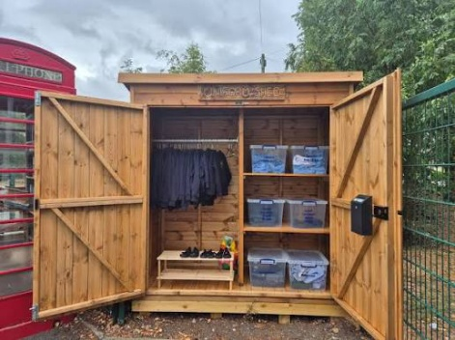
Trips, Events and Costs
We are committed to providing our pupils with a wide range of experiences, visits and enrichment opportunities throughout the year. We know how valuable these experiences are in bringing learning to life and creating lasting memories for our children.
Where possible, we work hard to keep costs to a minimum by applying for grants, seeking funding opportunities and making use of free local events and resources. However, there are occasions when we have to pass some of the costs on to parents and carers in order for visits and activities to go ahead.
We would like to thank families for their continued support and understanding.
We appreciate that the run-up to Christmas can be an expensive time, and we have listened carefully to the feedback that has been shared regarding costs.
To help reduce financial pressures, we will be limiting school charity events to one fundraising event per term. We are also working to share information about trips and events as early as possible, giving families plenty of notice to plan ahead.
As always, we welcome feedback and suggestions from parents and carers. If you have ideas about how we can make things better for everyone, please get in touch. Working together helps us provide the very best opportunities for all of our pupils.
UNIFORM SHED
We are pleased to let you know that our new
Uniform Shed will be arriving very soon. It will be
located near the main entrance and will be
available for families to access whenever needed.
The shed will be stocked with spare school uniform
and other useful items to support our families.
We hope this will provide a practical way for
parents and carers to access pre-loved items
while helping us reduce waste and support our
school community.
A donations box will also be available, and we would be very grateful for any contributions of clean, good condition uniform that your children have outgrown. Donations will help us keep the shed stocked and ensure it remains a useful resource for everyone.
As this is a new initiative, we would love to hear your ideas. If there are other items that you feel would be helpful for families, please let us know. By working together, we can ensure the Uniform Shed meets the needs of our school community and helps support as many families as possible.

Slide 7
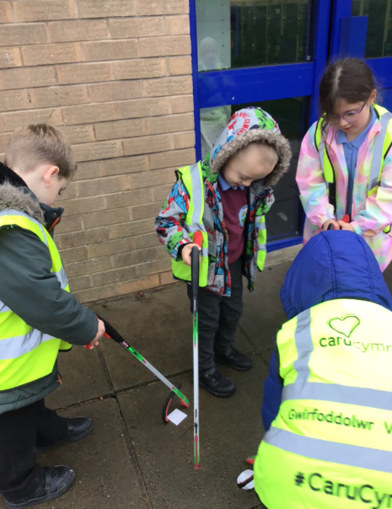
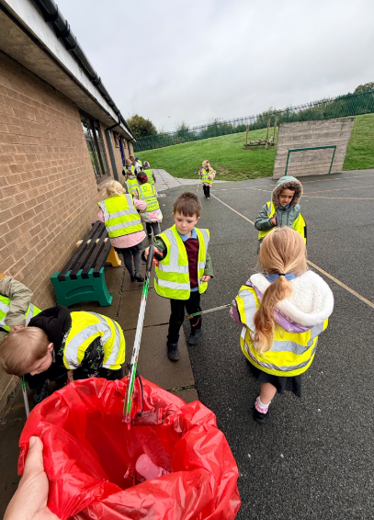
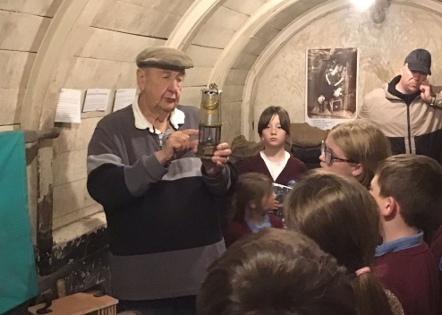
LITTER PICK
As part of their topic work based on the life
and work of Sir David Attenborough, pupils in
Woodpeckers and Robins classes took part in
a community litter pick around the school
grounds and village.
During the activity, the children discussed the
importance of caring for their local
environment and the impact that litter can
have on wildlife. They were excited to spot
Local animals, including birds and squirrels,
and talked about how discarded rubbish can
harm animals through injury, entanglement or
by being mistaken for food.
The litter pick gave the children an opportunity to put their learning into action by helping to keep our local area clean while thinking about how we can all play a part in protecting the natural world.
We were very proud of the enthusiasm, teamwork and sense of responsibility shown by the children. They were fantastic ambassadors for the school and demonstrated how small actions can make a big difference to our community and environment.
MINERS RESCUE
As part of their work on the Gresford Mining Disaster,
Magpies Class visited the Wrexham Miners Project
to learn more about this significant event in our
local history.
During the visit, the children explored what life was
like for miners and gained a greater understanding
of the difficult and often dangerous conditions they
worked in. They learned about the impact the
disaster had on local families and communities and reflected on how important the mining industry was to the area.
The children asked thoughtful questions throughout the visit and represented the school brilliantly. The trip provided a valuable opportunity to deepen their understanding of local history and the people who helped shape our community.

Slide 8
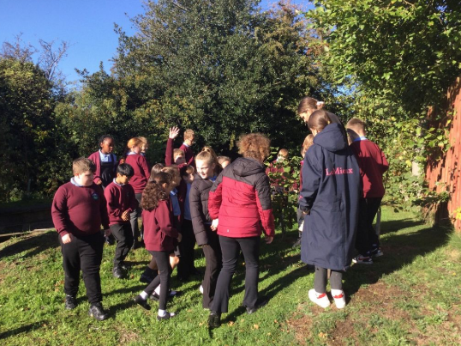
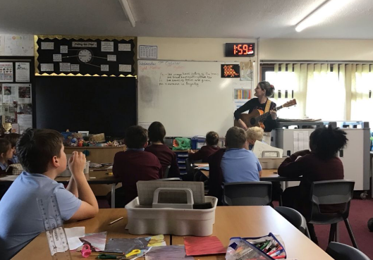
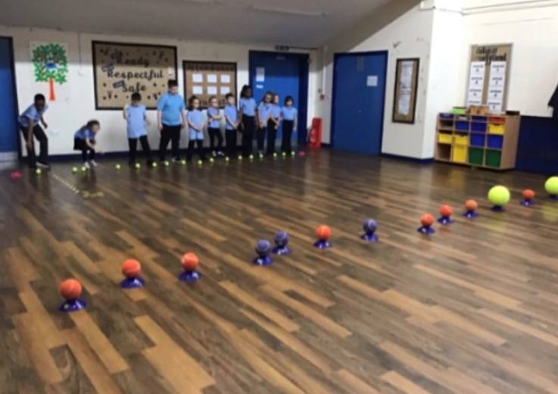
JUNIOR ART SESSIONS
This half term, we have been delighted to welcome
Elin, a local artist, into school to work with our pupils
on a range of creative projects.
The children have taken part in a variety of activities
Linked to art, drama and music, exploring Welsh
culture and expressing their own ideas through
different creative forms. The sessions have
encouraged teamwork, imagination and confidence,
while giving pupils the opportunity to develop new
skills and talents.
One of the highlights of the project was the children
creating their own Welsh folk song. They thoroughly
enjoyed the process of developing lyrics, exploring
traditional themes and performing their work together.
We are very grateful to Elin for sharing her expertise
and inspiring our pupils. The children have embraced
every activity with enthusiasm and creativity, and it
has been wonderful to see them enjoying the arts in
so many different ways.
CRICKET
This half term, all of our junior pupils have
been enjoying free cricket coaching
sessions delivered by Cricket Wales.
The sessions have given children the
opportunity to develop a range of
cricket skills, including batting, bowling,
catching and teamwork, while also
encouraging participation in physical
activity and sport.
We are very grateful to Cricket Wales for
providing this experience free of charge.
Opportunities such as these help to raise the profile of cricket within the school and give pupils the chance to try a sport with the help of trained specialists.
The children have shown great enthusiasm during the sessions and have thoroughly enjoyed learning new skills from specialist coaches. We hope that this experience will inspire more children to take an interest in cricket and continue participating in sport both in and out of school.

