Slide 1







BRYNTEG NEWS
July
2026
MESSAGE FROM THE HEADTEACHER
What a lovely year it has been. We’ve had so many fun times together — trips to the beach, exciting pantomime and theatre visits, our wonderful Christmas shows, and lots more. The children have worked hard, made friends, and grown in confidence. We are very proud of every single one of them.
This summer, we will be saying goodbye to Mr Morrison and Miss Bexon. They have been a big part of our school, and we will miss them very much. We wish them all the best for the future.
We also have some happy news to share. Mr Daulby has become a dad, and Mrs James is expecting her baby during the holidays. We send them lots of love at this special time.
Thank you for all your support this year. It really helps our school feel like a caring, friendly place for everyone.
School starts back on Wednesday, 2nd September 2026
at 8:40am. We can’t wait to see you all again.
Wishing you a safe, happy summer.
Mrs Firth
COMMUNICATION
Keep up to date with all that’s happening by visiting our website or following us on Facebook.
Please ensure we have your current mobile number so you receive our text messages, and don’t forget to sign up to Seesaw to see what’s happening in your child’s class.
You can also subscribe to our diary for Android or iOS. You can find the link on our website: https://www.brynteg-pri.wrexham.sch.uk/

Slide 2
DATES FOR YOUR DIARY
Please note - These dates are subject to change
JULY 2026 | SEPTEMBER 2026 | OCTOBER 2026
Friday 17th Last day of school | Tuesday 1st Staff training day Wednesday 2nd School open to pupils Friday 11th Individual photos Thursday 17th Flu immunisation | Wednesday 21st Parents Evening Friday 23rd Half term
NOVEMBER 2026 | DECEMBER 2026 | JANUARY 2027
Monday 2nd Staff training day Tuesday 3rd School open to pupils Friday 13th Children in Need Thursday 19th AGM Governors and Parents Thursday 26th Non Uniform Day Friday 27th Christmas Fair | Monday 7th Reception – Y2 Concert Tuesday 8th Y3 – Y6 Concert Wednesday 9th Nursery Concert Thursday 10th Christmas Lunch Thursday 17th End of term Friday 18th Staff training day | Monday 4th Staff training day Tuesday 5th School open to pupils
FEBRUARY 2027 | MARCH 2027 | APRIL 2027
Monday 1st Parents evening this week Friday 5th School closes for half term Monday 15th School open to pupils | Wednesday 10th Class photos Friday 19th End of term Date to be confirmed Red Nose Day | Monday 5th School open to pupils
MAY 2027 | JUNE 2027 | JULY 2027
Monday 3rd May Day Monday 10th Bikeability (Y5/6) Tuesday 11th Bikeability (Y5/6) Friday 28th Half term | Friday 18th Sports Day Monday 21st Scholastic Book Fair Tuesday 22nd Scholastic Book Fair | Friday 9th Pupil reports to parents Friday 16th School closes for end of year

Slide 3
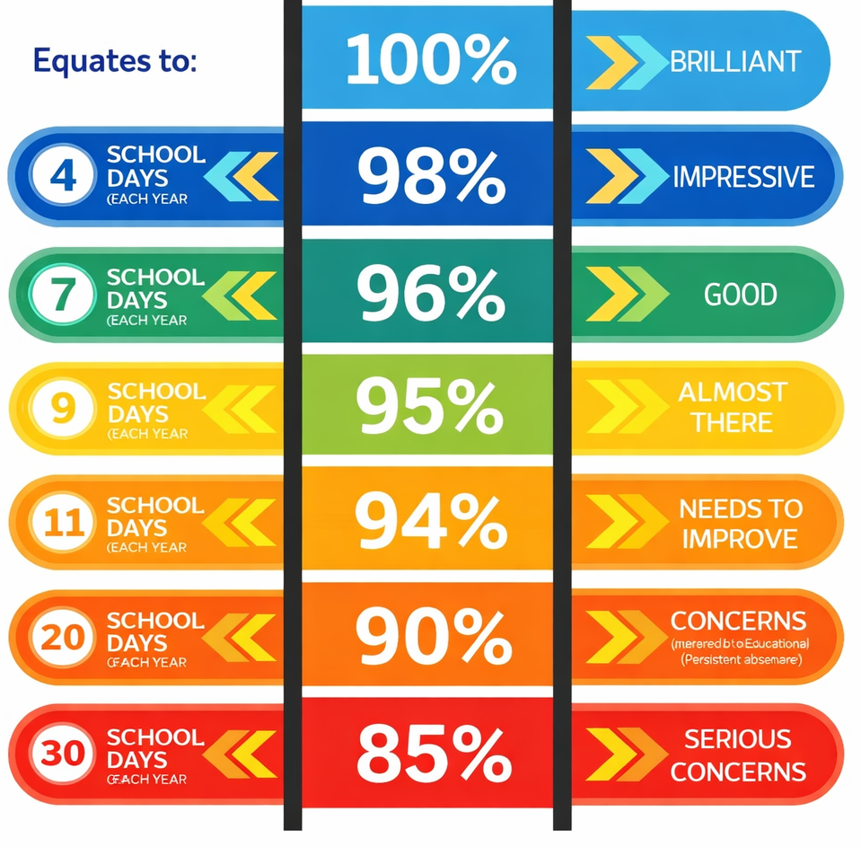

ATTENDANCE
Coming to school every day is really important for your child’s learning and wellbeing. A good routine helps children feel settled, confident, and ready to learn. When children miss a lot of school, it can make learning harder and
can affect how they feel in class.
We want every child to have the best chance to do well.
Our school follows the Local Authority Attendance Procedures, which means we are required to send attendance letters when a child’s attendance drops to a certain level — no matter what the reasons are. We know these letters can sometimes feel worrying, but they are simply the best way for us to keep you updated and make sure you know what is happening.
All holidays in term time are unauthorised, unless there are special circumstances. This is part of the Local Authority model, and we must follow it.
If your child is off school, please phone us on the first day of absence. If the absence is for medical reasons, please try to give us evidence (like an appointment card, prescription, or note from a doctor). This helps us record things correctly.
We are working closely with Wrexham Attendance Officers to support families where children are missing school often. We want to help, not judge. If there is anything going on at home that might affect your child’s attendance, please come and talk to us. We are here to listen and work with you.
Thank you for trying
your best to get your
child into school every
day. Your support
makes a big difference.
Our full attendance
policy is available on
our school website, so
you can read more
about how it all works.

Slide 4
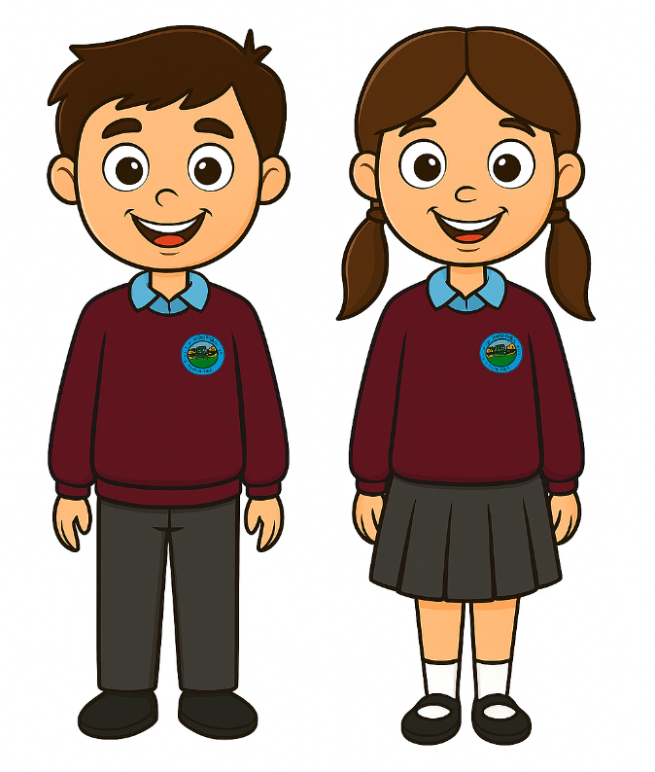
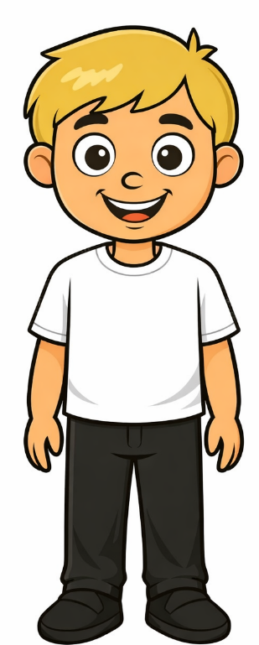

UNIFORM
As we look ahead to the new school year, we want to make sure everyone is clear about our uniform expectations.
Wearing the correct uniform helps children feel part of the school community and ready to learn — it also keeps things fair and consistent for everyone.
We are keen for everyone to wear uniform so we recommend following the offers in supermarkets and online. We will share any offers we see to help you get the best value for money.
If you would like to purchase items with the school logo, they are available at RAM Leisure https://ourschoolwear.co.uk/collections/brynteg-c-p-school
Here’s what pupils should wear:
Everyday uniform
Maroon jumper or cardigan
Blue polo shirt
Grey trousers or skirt
Black shoes
PE kit
Plain white T‑shirt
Black shorts, leggings, or jogging bottoms
School jumper or cardigan if it’s chilly
Please note: no coloured tops, football
shirts, or coloured trainers are allowed for
PE or school days.
We want all children to look neat and
ready to learn.
We’ll be keeping an eye on uniform
next year and will send a short note home
if a child isn’t in the correct kit — just to
help everyone stay consistent.

Slide 5



SCHOOL MEALS
We’ve noticed an increase in children saying they
don’t want, or don’t like, the meals they’ve ordered
for lunch. We completely understand that tastes can
change, and we know it can be tricky to please
everyone every day!
We really appreciate that these meals are free, and
that they help to ease the financial pressure for
families. However, it can be challenging for staff
when children refuse the food they’ve chosen —
especially as we aren’t able to change meal
choices once they’re in the system.
Please could parents sit with their children at home and look through the menu together before ordering. Talking about the options and helping them make a choice they’ll enjoy makes a big difference.
We do have the capacity to book meals for children who miss the cut‑off time or experience technical difficulties, but this takes away from valuable learning time. We kindly ask that you try to book meals at home whenever possible.
If you’re having problems logging in or accessing the system, please let the school office know — we’ll do our best to help you get it sorted quickly.
Thank you for your support in helping us make lunchtimes positive and enjoyable for everyone.
BREAKFAST CLUB
The school offers breakfast club for those who require it. The cost from 7:45 until 8:15 is £3 (£1 for children eligible for free school meals) but it is FREE from 8:15. You can book and pay on Parent Pay.
Are you eligible for free school meals? If you are on a low income, you may be entitled to free school meals as well as the School Essentials grant to help with buying school uniform and equipment. Please visit
https://www.wrexham.gov.uk/service/school-essentials-grant to apply. You may also receive financial support for residential trips.
SNACK
We are seeing an increase in the number of children bringing in crisps, chocolates and pastries as their snack. We would like to remind you that we aim to be a healthy school and would like all children to bring in fruit, vegetables, yoghurts or cheese.
We understand that everyone has a preference for different foods but we would like to encourage healthy habits from a young age.
Thank you for your support

Slide 6



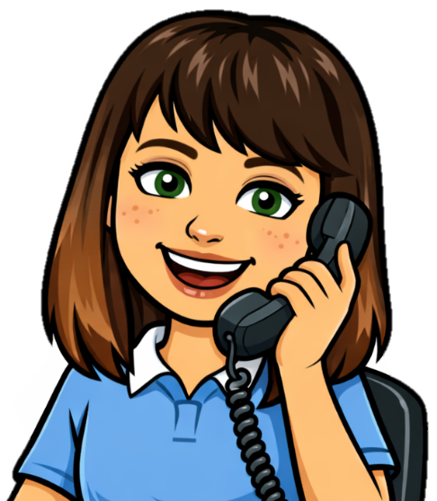
BEHAVIOUR
As we prepare for the new school year, we want to remind families of our shared commitment to maintaining a positive environment for all. Our school rules are simple: READY, RESPECTFUL, SAFE — and we expect every pupil to behave in a way that promotes these values.
In the autumn term, all pupils will learn what it means to be ready, respectful, and safe, and how these principles guide their actions in class, around school, and in the wider community.
To support this, we will be sending out a Behaviour Contract to all parents. This contract outlines our expectations and how families can help reinforce them at home. If you do not wish to adhere to the contract, please contact us by email to discuss your concerns.
We appreciate your support in helping every child understand and live by our school values — together, we can ensure a calm, safe, and successful learning environment for all.
COMMUNICATION
At Brynteg CP School, we are always striving to be better. We are human, and like everyone, we sometimes make mistakes — but we are committed to learning, improving, and working in partnership with you. There will be times when you need to speak with us, and we want that process to feel open, supportive, and straightforward.
The best place to start is always with your child’s class teacher. Teachers are on the doors before and after school and are happy to talk. If you prefer a private conversation, they will gladly arrange a meeting at a time that suits you. Going to the teacher first is always the most effective step — they spend the day with your child and can answer questions quickly and accurately.
Staff will also respond to messages through Seesaw, but please remember that they have lives outside school, so replies will be made during working hours.
If you feel your concern hasn’t been fully resolved, you
are welcome to speak with Mrs Jones or Mrs Firth. You
can contact the school by phone or email, and we
will ensure your query is handled promptly and
professionally.
We value open communication, mutual respect,
and the strong relationships we build with our
families. Working together, we can continue to
make Brynteg CP School the best place for every
child to learn and grow.

Slide 7
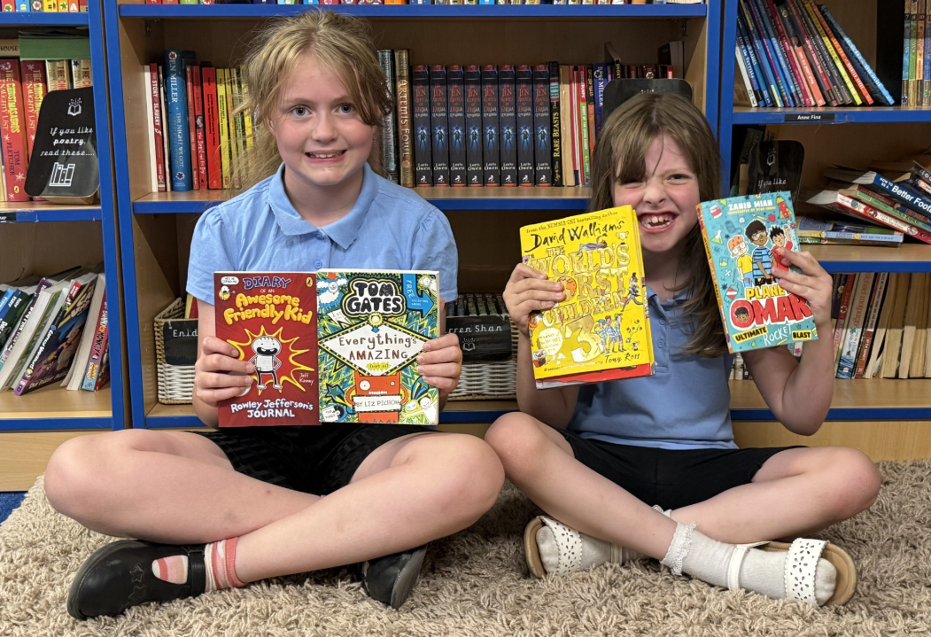
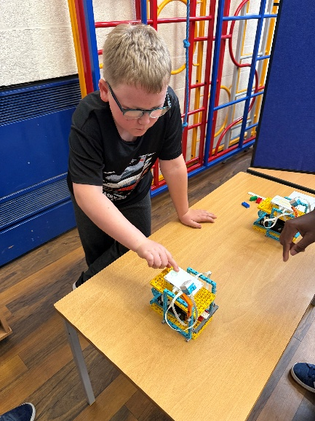
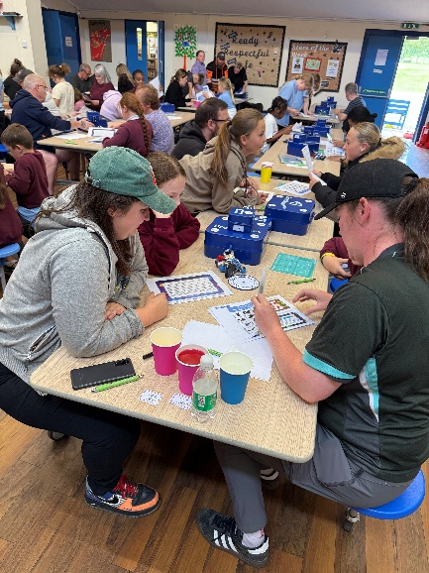
BOOK FAIR
We were delighted to see
such a wonderful turnout
for our Book Fair. It was
lovely to see so much
enthusiasm for reading
and to watch our children
and families exploring new
books together.
Thanks to your support,
the school received almost
£200 worth of books, which
will directly boost our
Reading for Pleasure
provision. These new books
will help us continue building a rich, inviting reading culture across Brynteg CP School.
Thank you for helping us make reading such a joyful part of school life.
FAMILY SCIENCE EVENT
We had a wonderful turnout for our Reaching
Wider STEM event, run in partnership with Bangor
University, Wrexham University, and Reaching Wider.
It was fantastic to see families working together,
solving problems, and showing brilliant teamwork
as they tackled the Escape Room in a Box
challenge.
A huge congratulations to Carlos and Oliver’s team, who were the first to open the box and win vouchers. Their teamwork, code‑breaking skills, and determination were amazing.
Thank you to everyone who joined us — your enthusiasm made the event a real success.

Slide 8
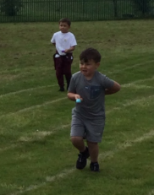
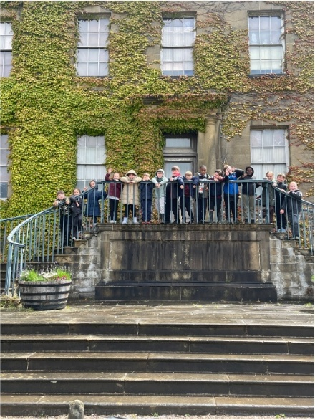
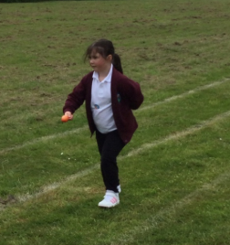
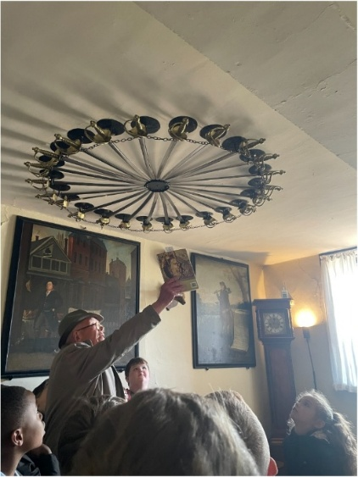
SPORTS DAY
It’s hard to believe that we spent so much
time weather‑watching and rain‑dodging
to make sure Sports Day could go ahead
— especially now that the sunshine has
been glorious ever since! Thankfully, we
managed to run the event on exactly the
right day.
The children were wonderful, showing
great enthusiasm, teamwork and
sportsmanship throughout. It was also
fantastic to welcome so many family
members to school; your support always
makes these events even more special.
Well done to everyone involved — a
brilliant day all round.
ERDDIG TRIPS
Our junior pupils had a fantastic opportunity this term to experience Erddig’s Wolf’s Den and take part in outdoor learning. Although it turned out to be a very rainy week, we were extremely fortunate to be given access to the house, allowing pupils to explore and learn about life in the past.
The children were wonderful throughout — engaged, curious, and incredibly respectful. Several members of the public even took the time to comment on their excellent behaviour, which made us very proud.
A memorable learning experience, despite the weather.

Slide 9
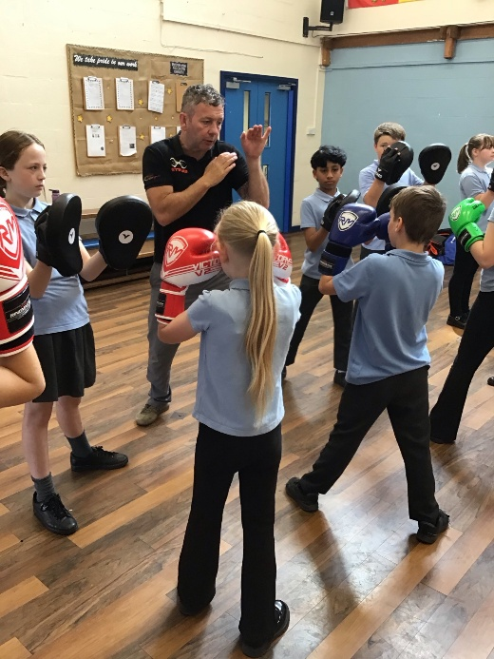
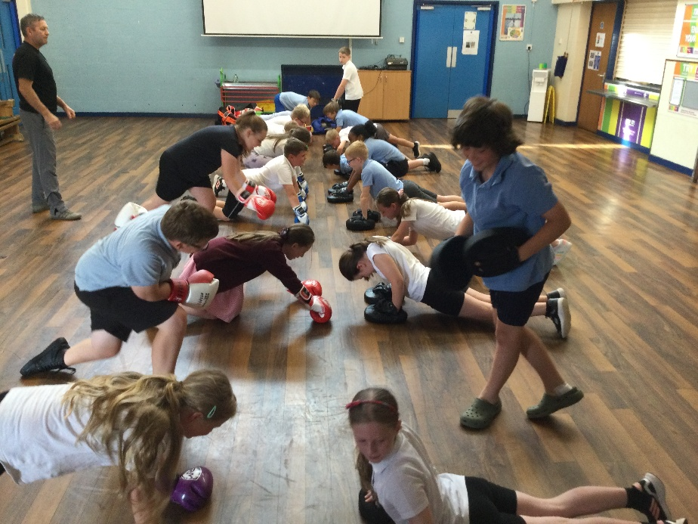
COMMON TRANSFER DAY
Our Common Transfer Day was a real success. It was wonderful to see pupils responding so positively to their new classes and teachers, settling in with confidence and enthusiasm.
We were especially impressed with our Year 2 pupils, who became juniors for the day. They were fantastic — showing maturity on the playground, excellent behaviour in the dinner hall, and great focus with their new teacher. They truly rose to the challenge.
All teachers are now looking forward to welcoming their new classes in September and continuing the brilliant work already underway.
BOXING
Nigel from Welsh Boxing has very kindly
donated his time to the school this half term,
delivering high‑quality boxing sessions to our
Year 5 and Year 6 pupils. The children
responded brilliantly to his instruction,
showing great focus, enthusiasm and respect
throughout each lesson.
It was wonderful to watch their footwork,
attacking skills, and defensive techniques
develop week by week. The pupils showed
real resilience and determination, and Nigel
was extremely impressed with their progress.
A huge thank you to Nigel for giving our
pupils such a valuable and memorable
experience.

Slide 10
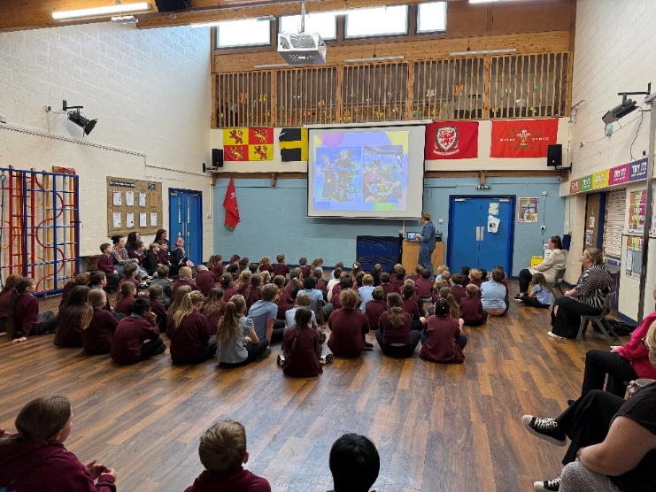
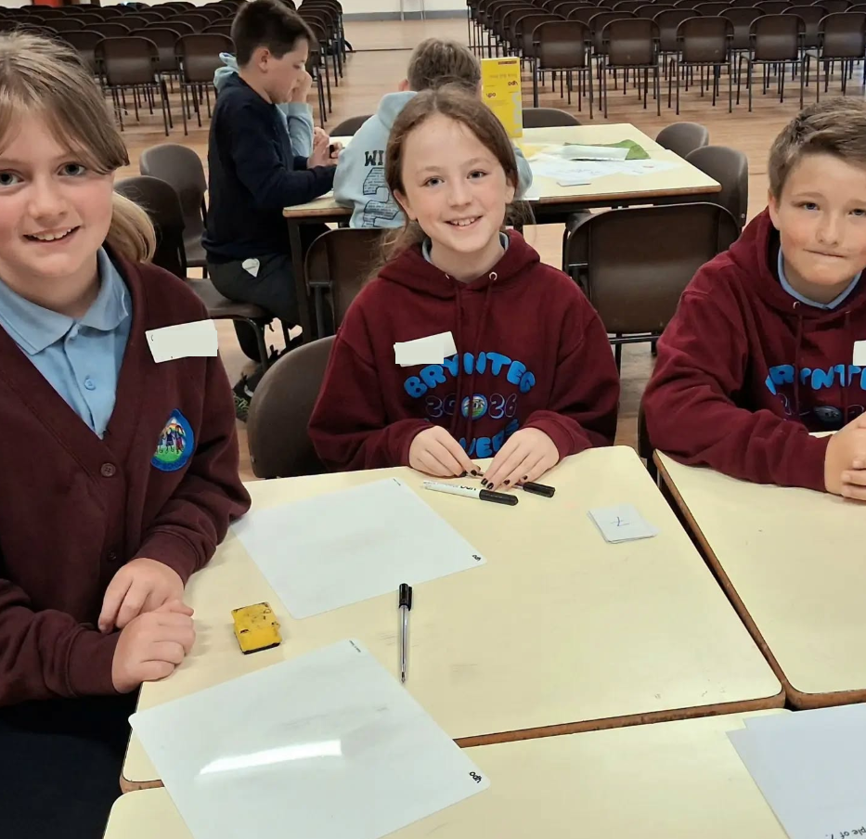
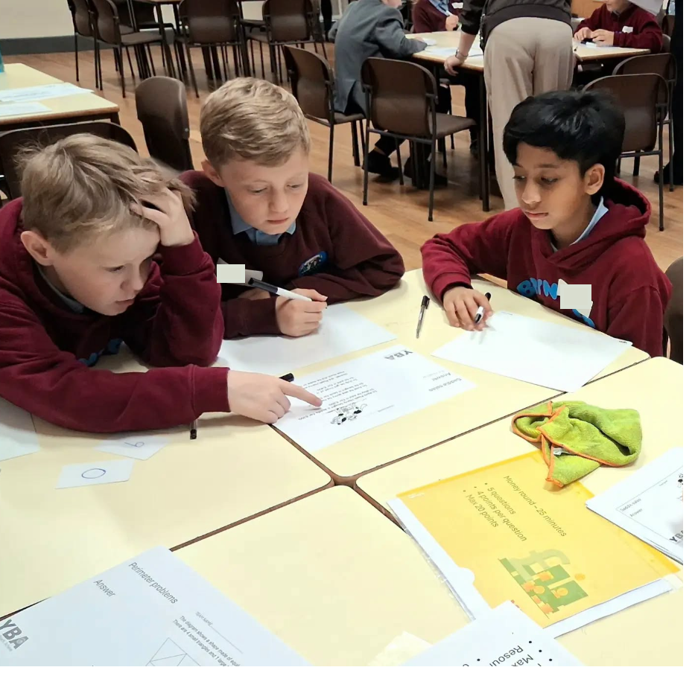
HOPE HOSPICE
Hope House Hospice recently led
a whole‑school assembly to help
our pupils learn more about the
incredible work they do. It was
lovely to see how caring,
thoughtful, and responsive the
children were throughout — they
listened beautifully and showed
real empathy.
Following our conversation with
the charity, we have decided to
hold a charity day in the autumn.
Instead of asking for money, we will be collecting donations for the Hope House charity shops. If you have any items at home that you no longer need but feel could be sold, please hang on to them — we will share the date and details closer to the time.
Thank you for supporting such an important cause and for helping our pupils understand the value of kindness and community.
MATHS CHALLENGE
Pupils from Year 4 to Year 6 were selected to take part in a Numeracy Challenge at Ysgol Bryn Alyn, competing against schools from across the local area. The children represented Brynteg brilliantly, showing impressive problem‑solving skills, determination and resilience throughout the event.
We are incredibly proud to share that one of our teams came third — a fantastic achievement in a very competitive field.
Well done to all the pupils who took part. They demonstrated exactly the kind of teamwork and perseverance we value at Brynteg CP School.

