Slide 1
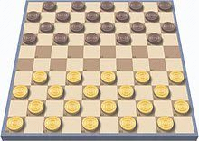
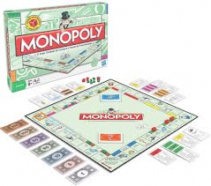
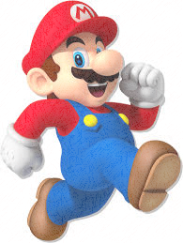
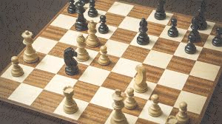
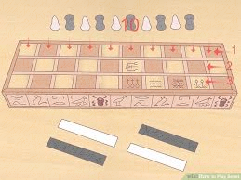
TOPIC: Games Home learning Menu
Write a review of a game (board, playground, computer
Write a biography of a famous video game character (Mario etc.)
Write a newspaper article about an upcoming game.
Make your own board about a topic of your choice (make the cards, counters etc.)
Research the first board game that ever existed
Compare a recent board game and an old fashioned board game
Make and design a new play ground game including the rules.
Go on hourofcode.com and complete some coding activities
Make a timeline of important dates in video games or board games (or games in general)
Create a character profile
Write a letter to a game developer, persuading them to make a game that you have designed
Research how many copies of different board games/ video games were sold and put them into a table
Design a new board of a pre-existing board game (e.g. Monopoly)
Make a storyboard about the story of your game
Research where different games were designed and plot them on a map
Research China and its video game culture
Make an advert for your favourite game
Design a poster for your favourite game
Write out the rules and design the game of ‘senet’
Research some facts on Senet
Design and make a board game that would be suitable for children
Compare and contrast games from then and now
Research the Olympic Games and display your research however the
Research Shigeru Miyamoto and write down 10 facts about his life.
Record a news report about the release of a brand new game (it could be a made up, or an old one)
Record a song or a rap about a game
Design and make your own console design.
Make and design an outfit that looks like a character from a game
Play some board games with your family and write a review on how good or bad you thought the game was.
Highlight the tasks you have completed and add them to your folder

Slide 2
Daily Activities
Reading (if you finish a book, write a review of your thoughts, if you a google ‘book review template’ it will show you what to write about)
One maths activity from the booklet you’ve been given.
Times Tables Rockstars or Numbots
At least one activity from the home learning menu
If you want to complete ANY activity on ANY topic that you want. Please do it and bring it in/ upload it to seesaw.
My hwb email address is daulbym6@hwbcymru.net if you want to ask me any questions, just want a chat or if you are worried about anything. I will check my emails daily and respond as soon as I can. Please use your hwb email address which is on your digital passport.
Keep working as hard as you do in class and keep safe
☺ ☺ ☺

Slide 3
Parents
The topic of ‘games’ was chosen by the class after we learned of the shutdown. This is a brand new activity and we haven’t done any work on this in class. We were coming to the end of the WW2 topic and we had covered most of the interesting activities.
We have attached a list of fantastic websites and programmes that can be used to enhance your child’s education. Twinkl have an incredible amount of worksheets and activities available and are offering their services for free in these challenging times.
We have also sent home your child’s digital password for access to lots of fantastic programmes. Please keep this safe.
I have also attached another seesaw login for those who haven’t already signed up. Lots of your child’s work is on here, and you can message me if you have any worries about anything
Children also have an incredible amount of programmes attached to their Hwb account for free, including Microsoft office software, J2e and emails.

Slide 4
Minecraft
Every child with a Hwb login (which your child does) has free access to Minecraft: education edition.
Go to the following website and follow the instructions to get free access to Minecraft: The education edition
https://hwb.gov.wales/microsoft#how-to-get-minecraft:-education-edition-at-home
On the ‘Minecraft for education’ website, go to class resources -> find a lesson and on there are loads of challenges and lessons that you can complete.

